Slide 1
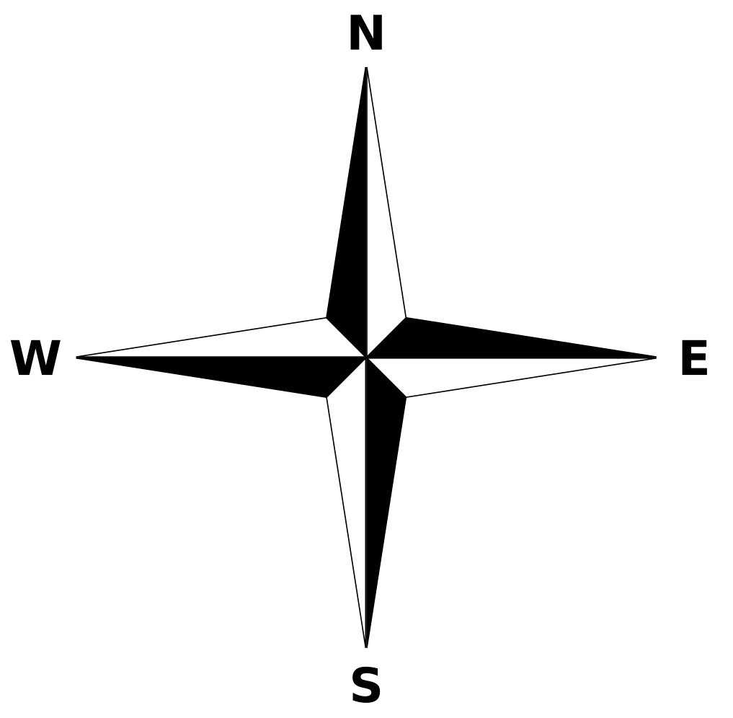
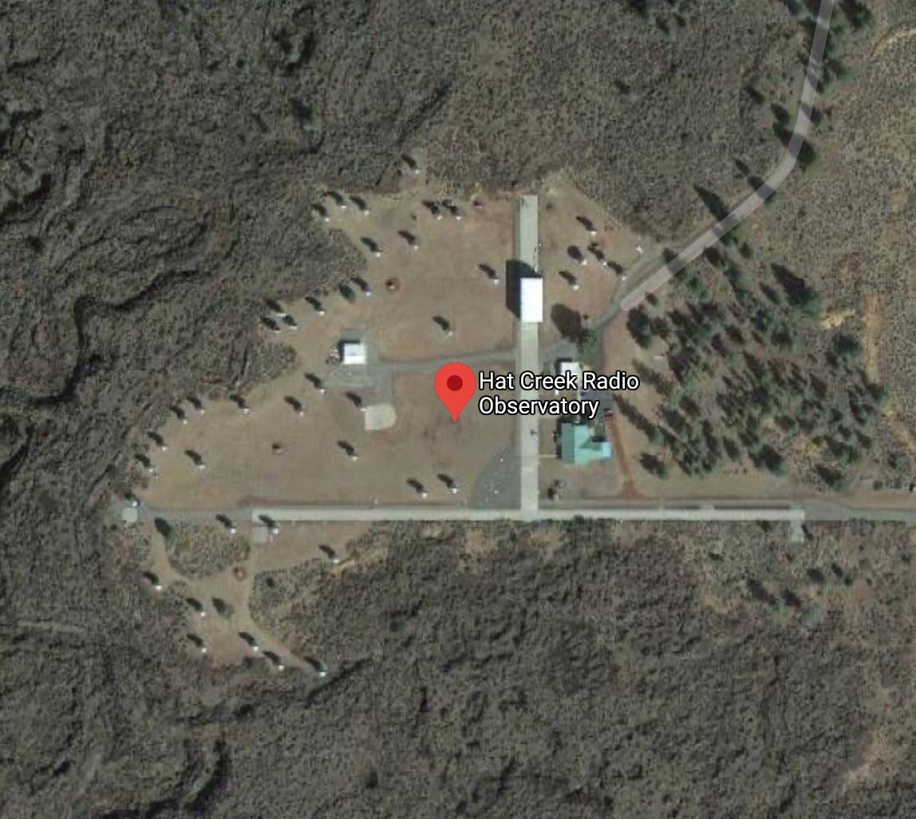
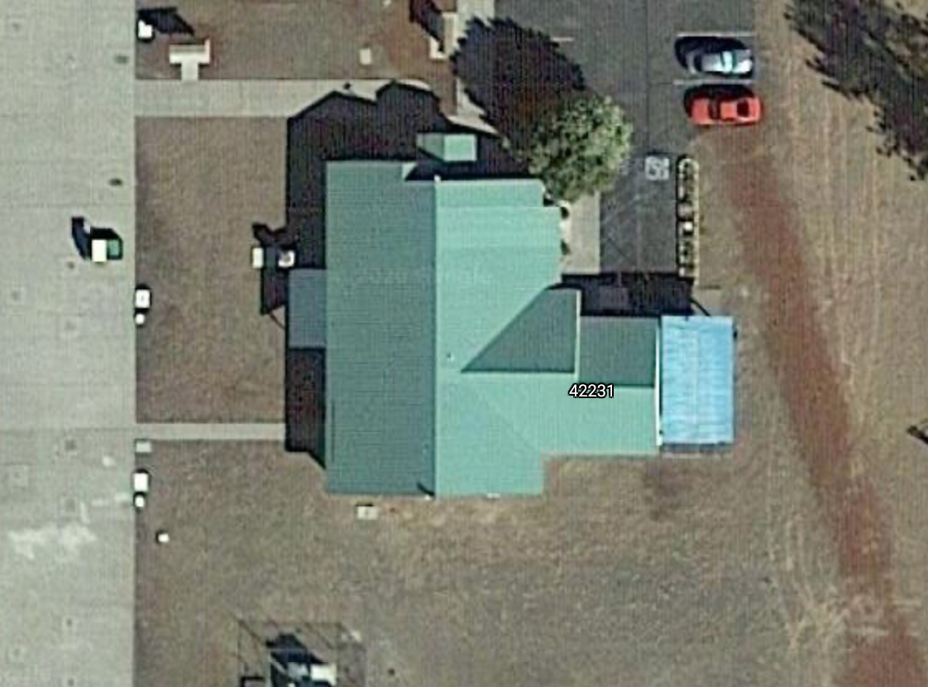
Visitor Center
Visitor Center (zoomed in)

Slide 2
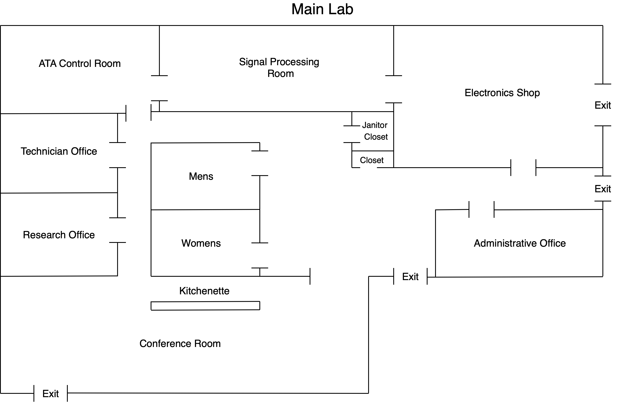
/ Visitors Center
Sometimes visitors go through here and pop into the control room
Main visitor area
Visitors enter here
Could be used for more visitor space but won’t always be available due to meetings

Slide 3
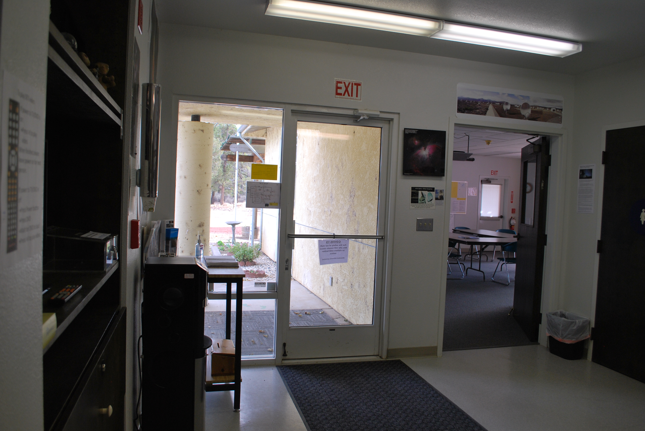
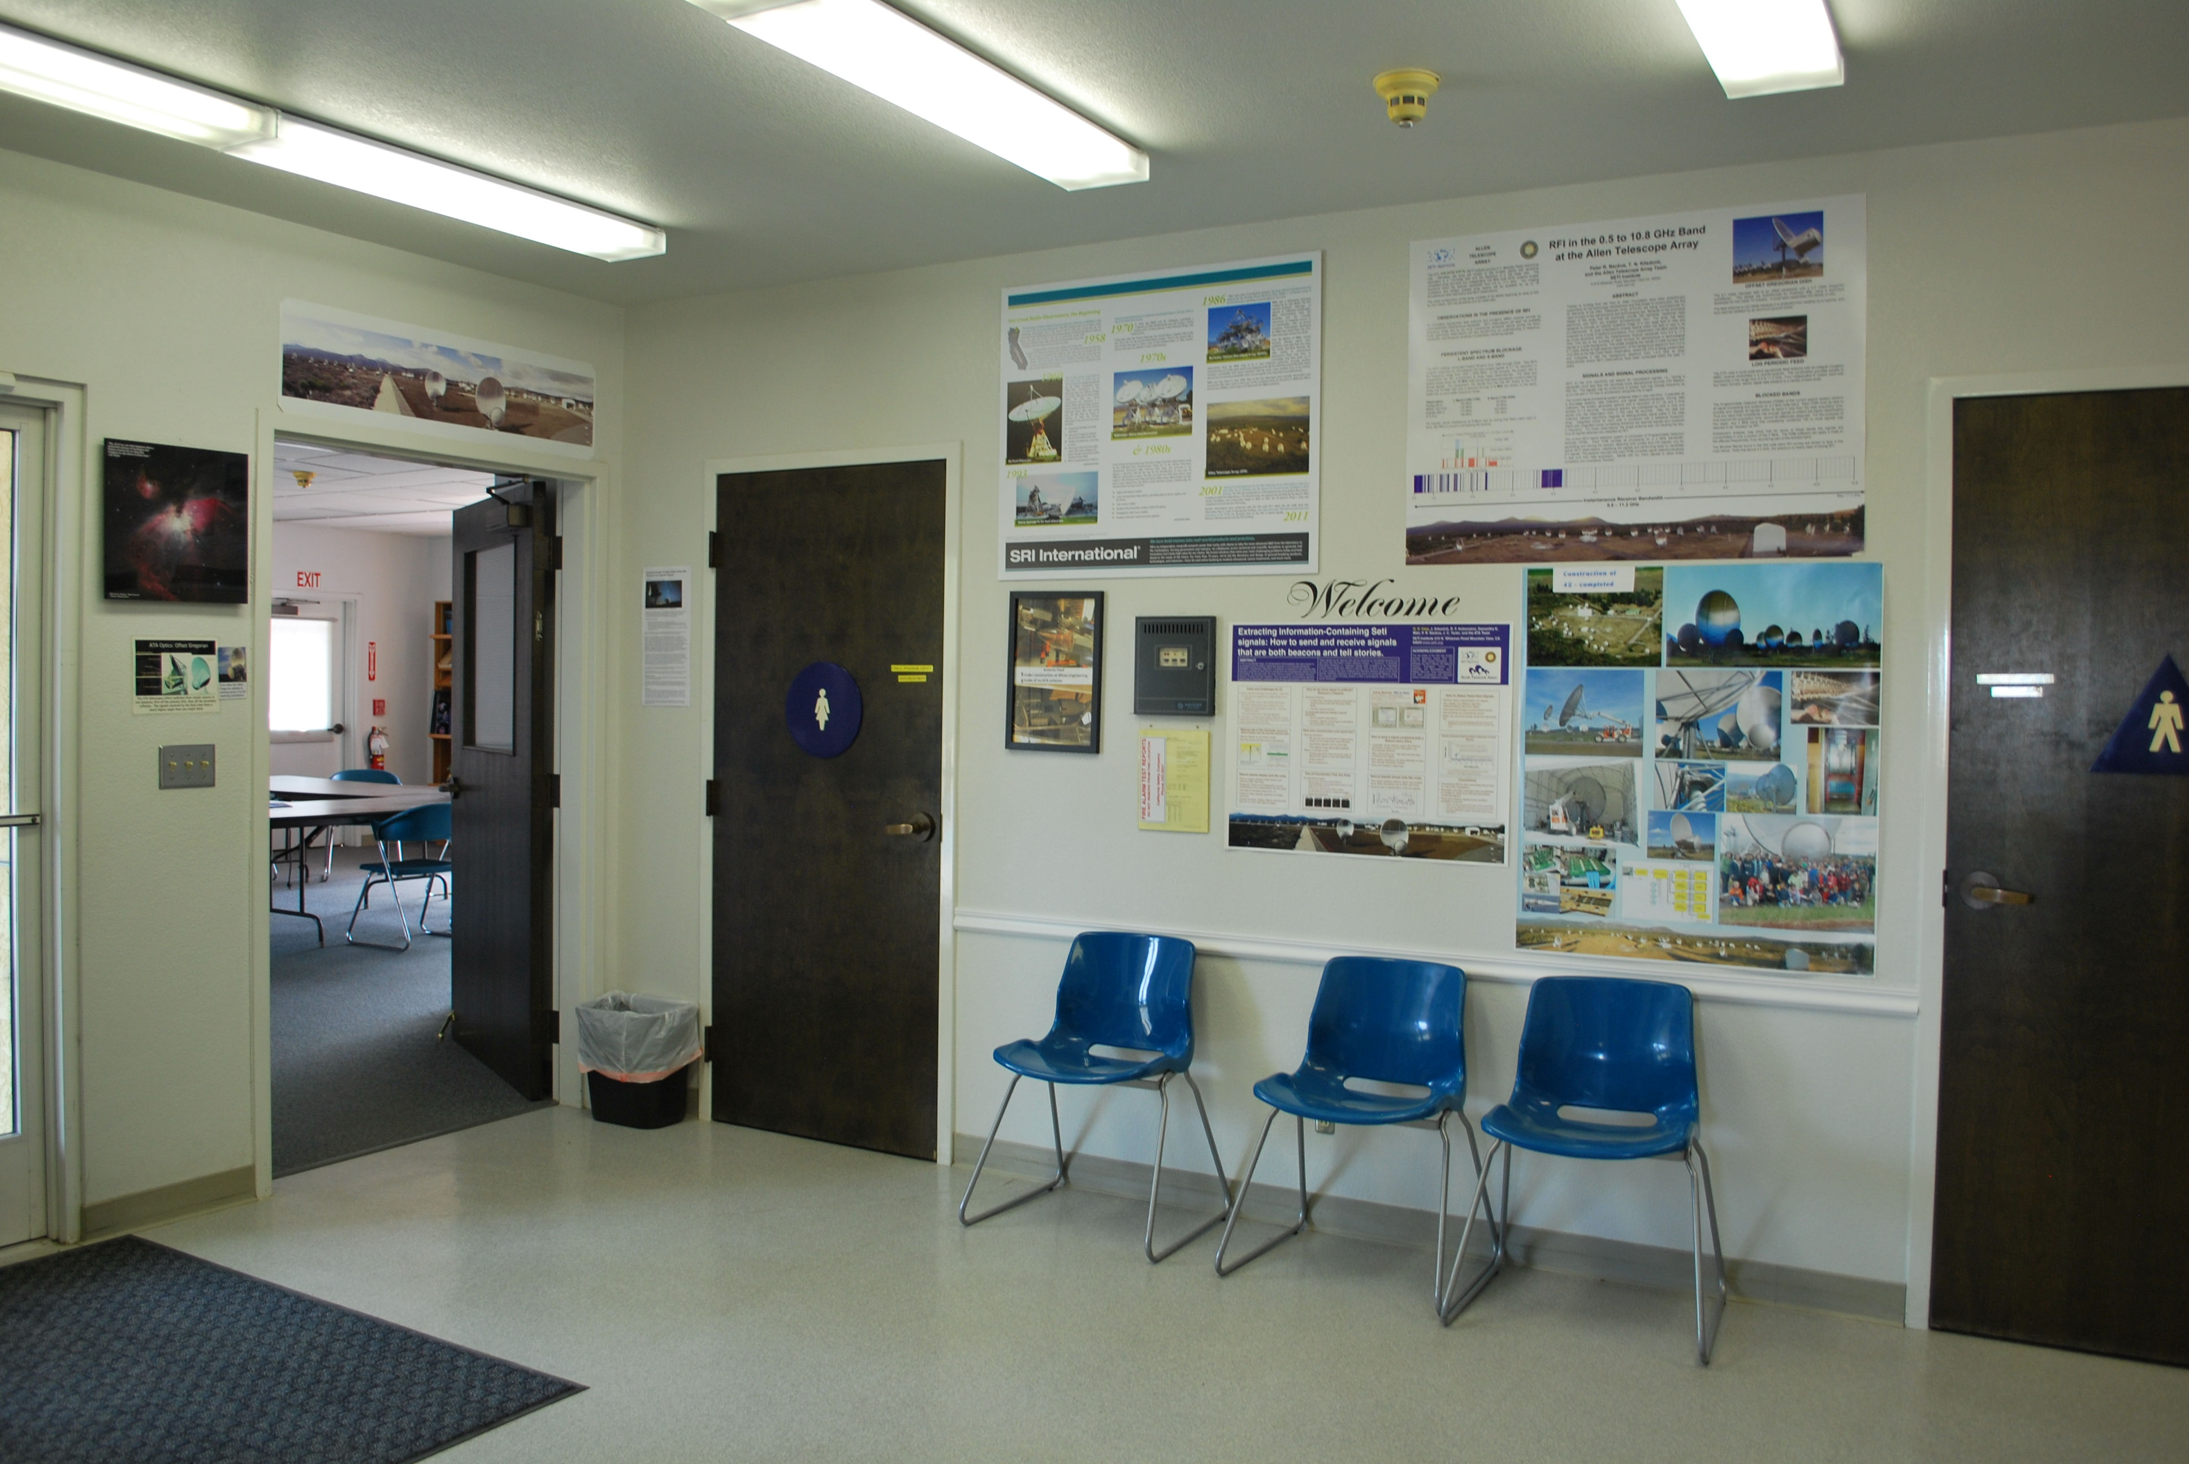
Main Entrance
Main Lobby

Slide 4
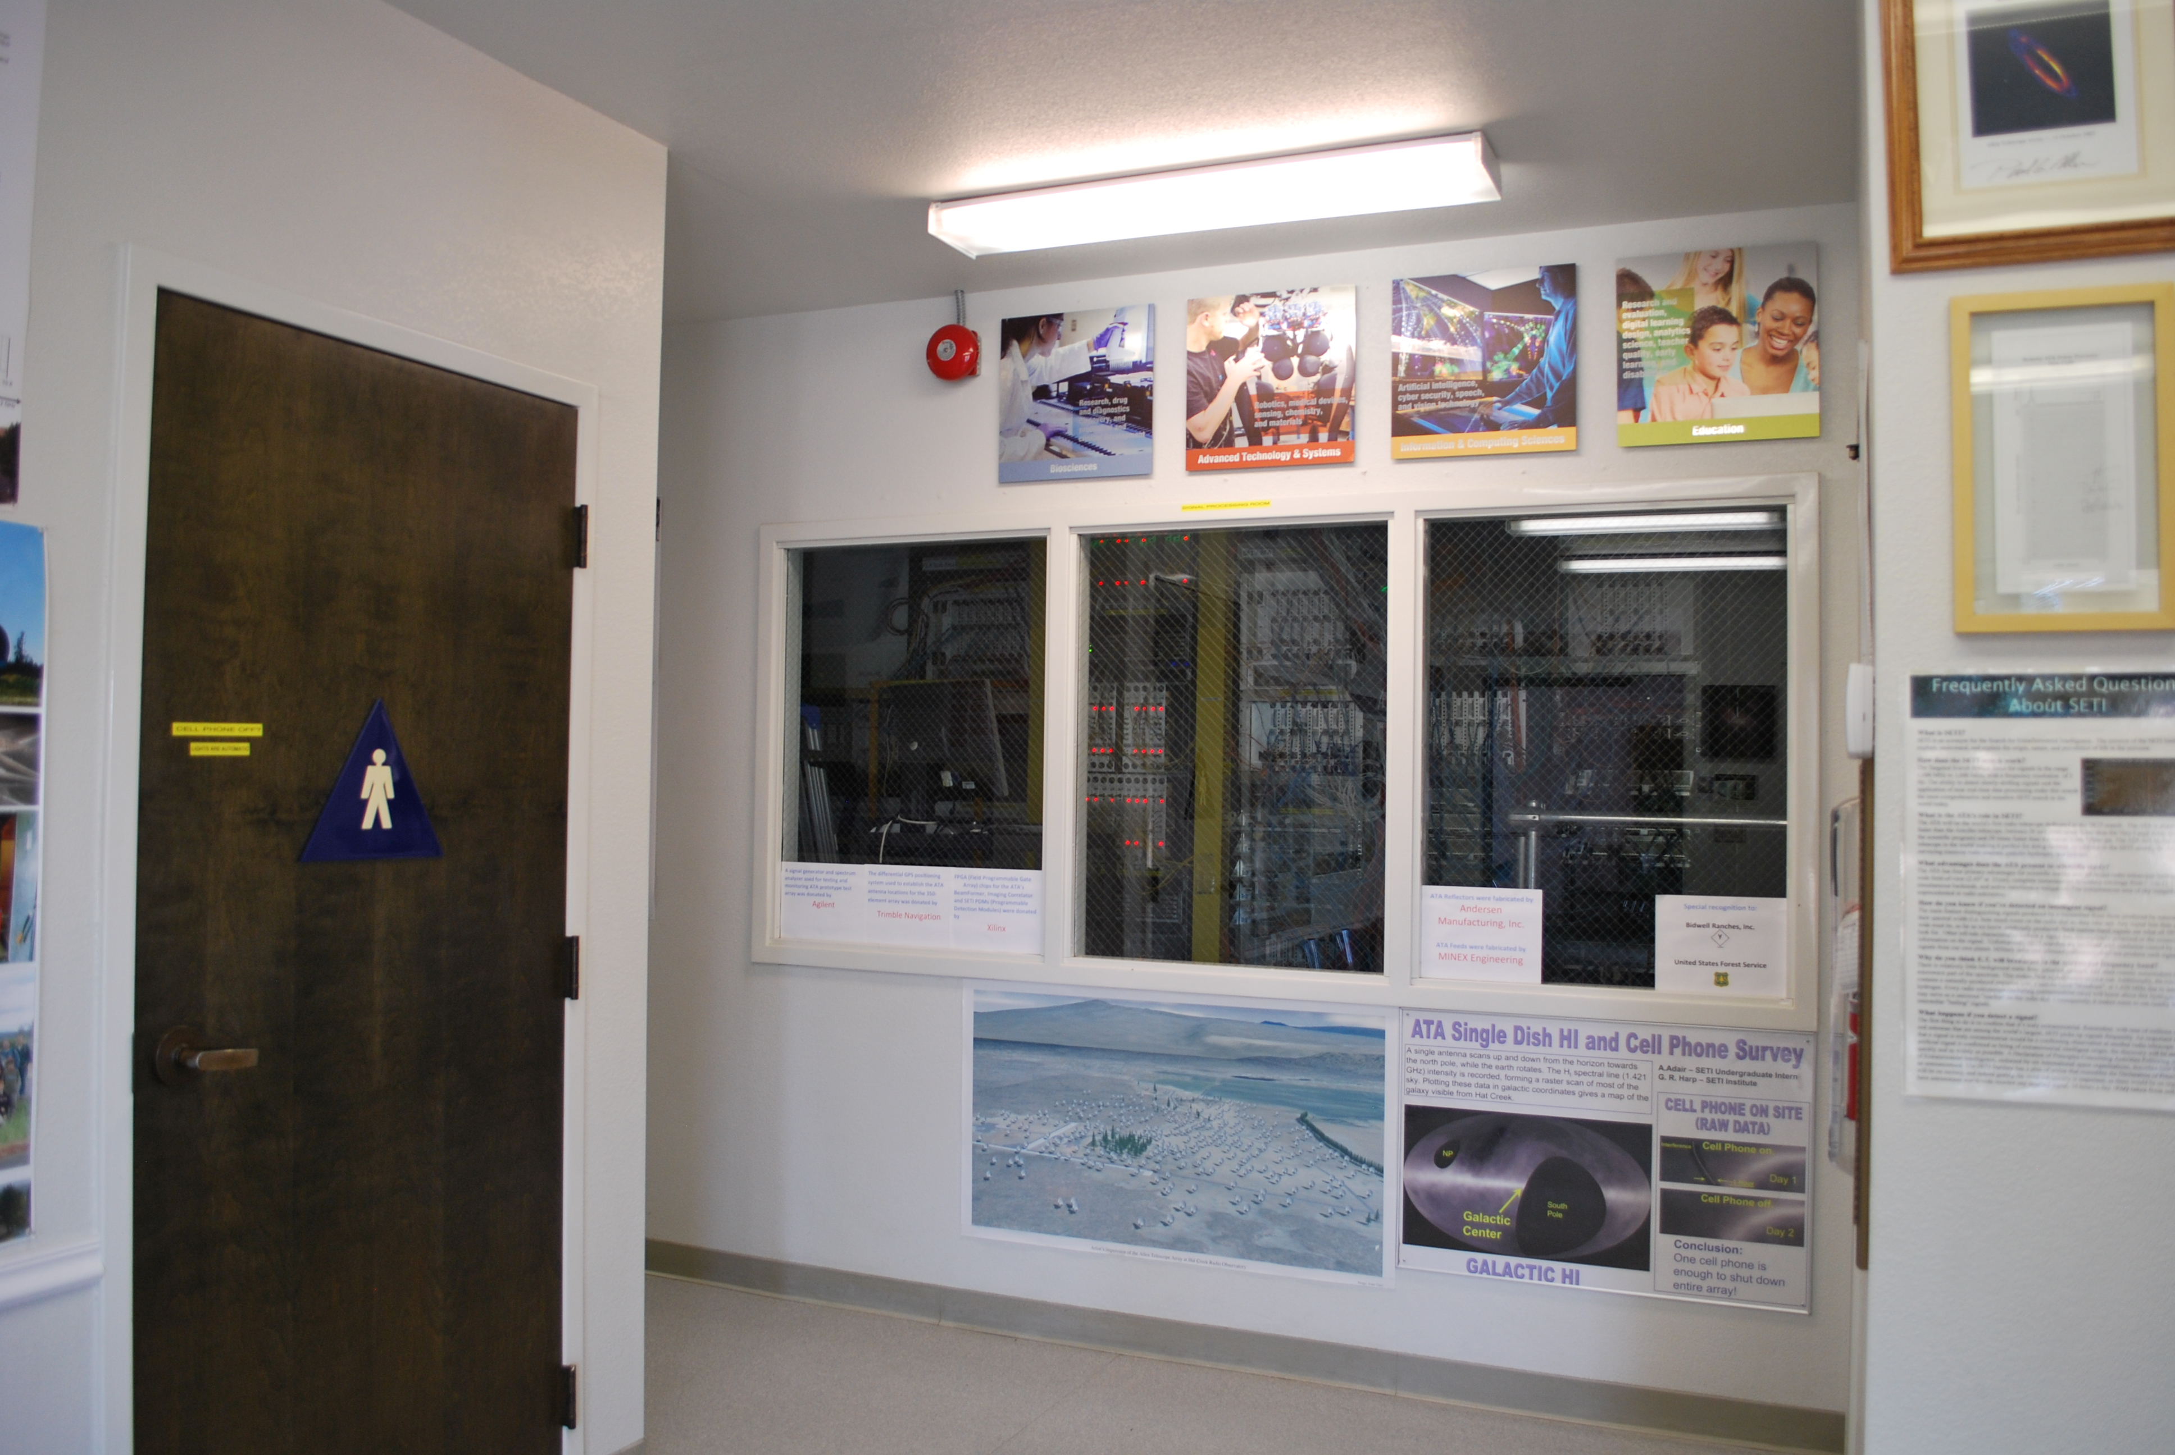
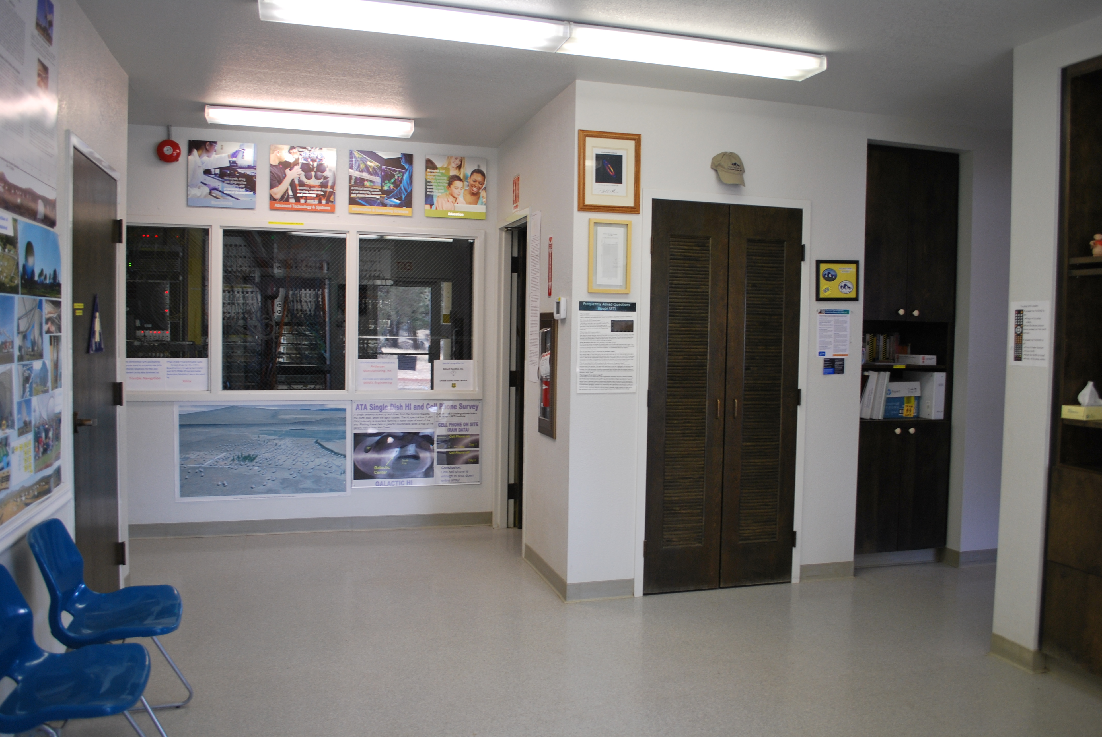
Main Lobby
Main Lobby

Slide 5
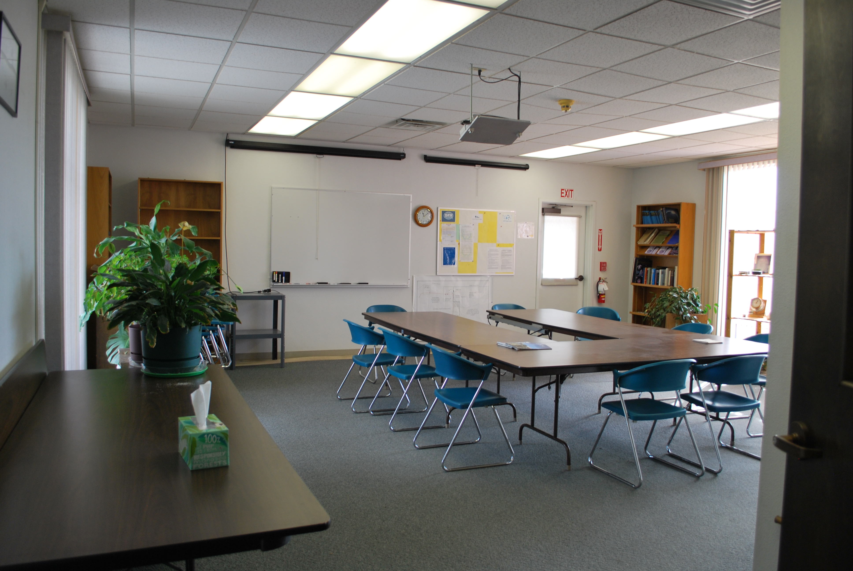
Conference Room

Slide 6
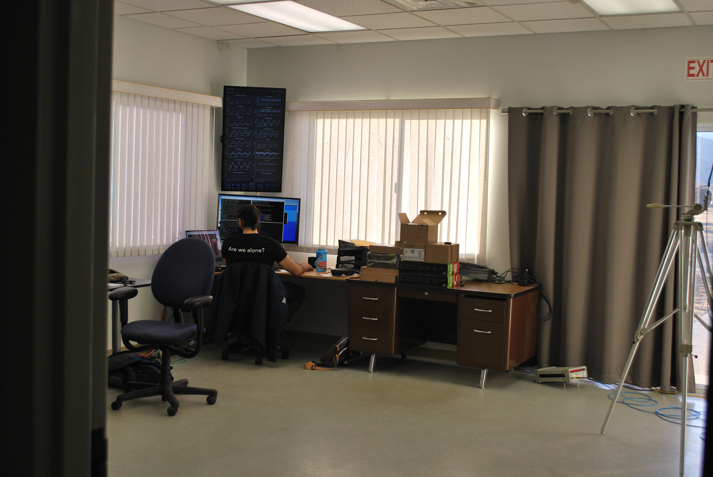
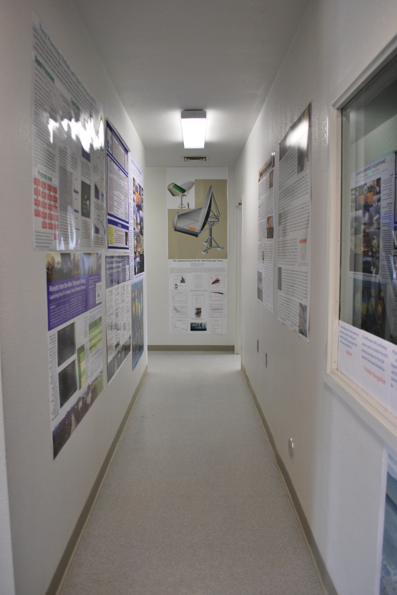
Hallway noted in floor plan
Peaking into the control room from hallway door

Slide 7
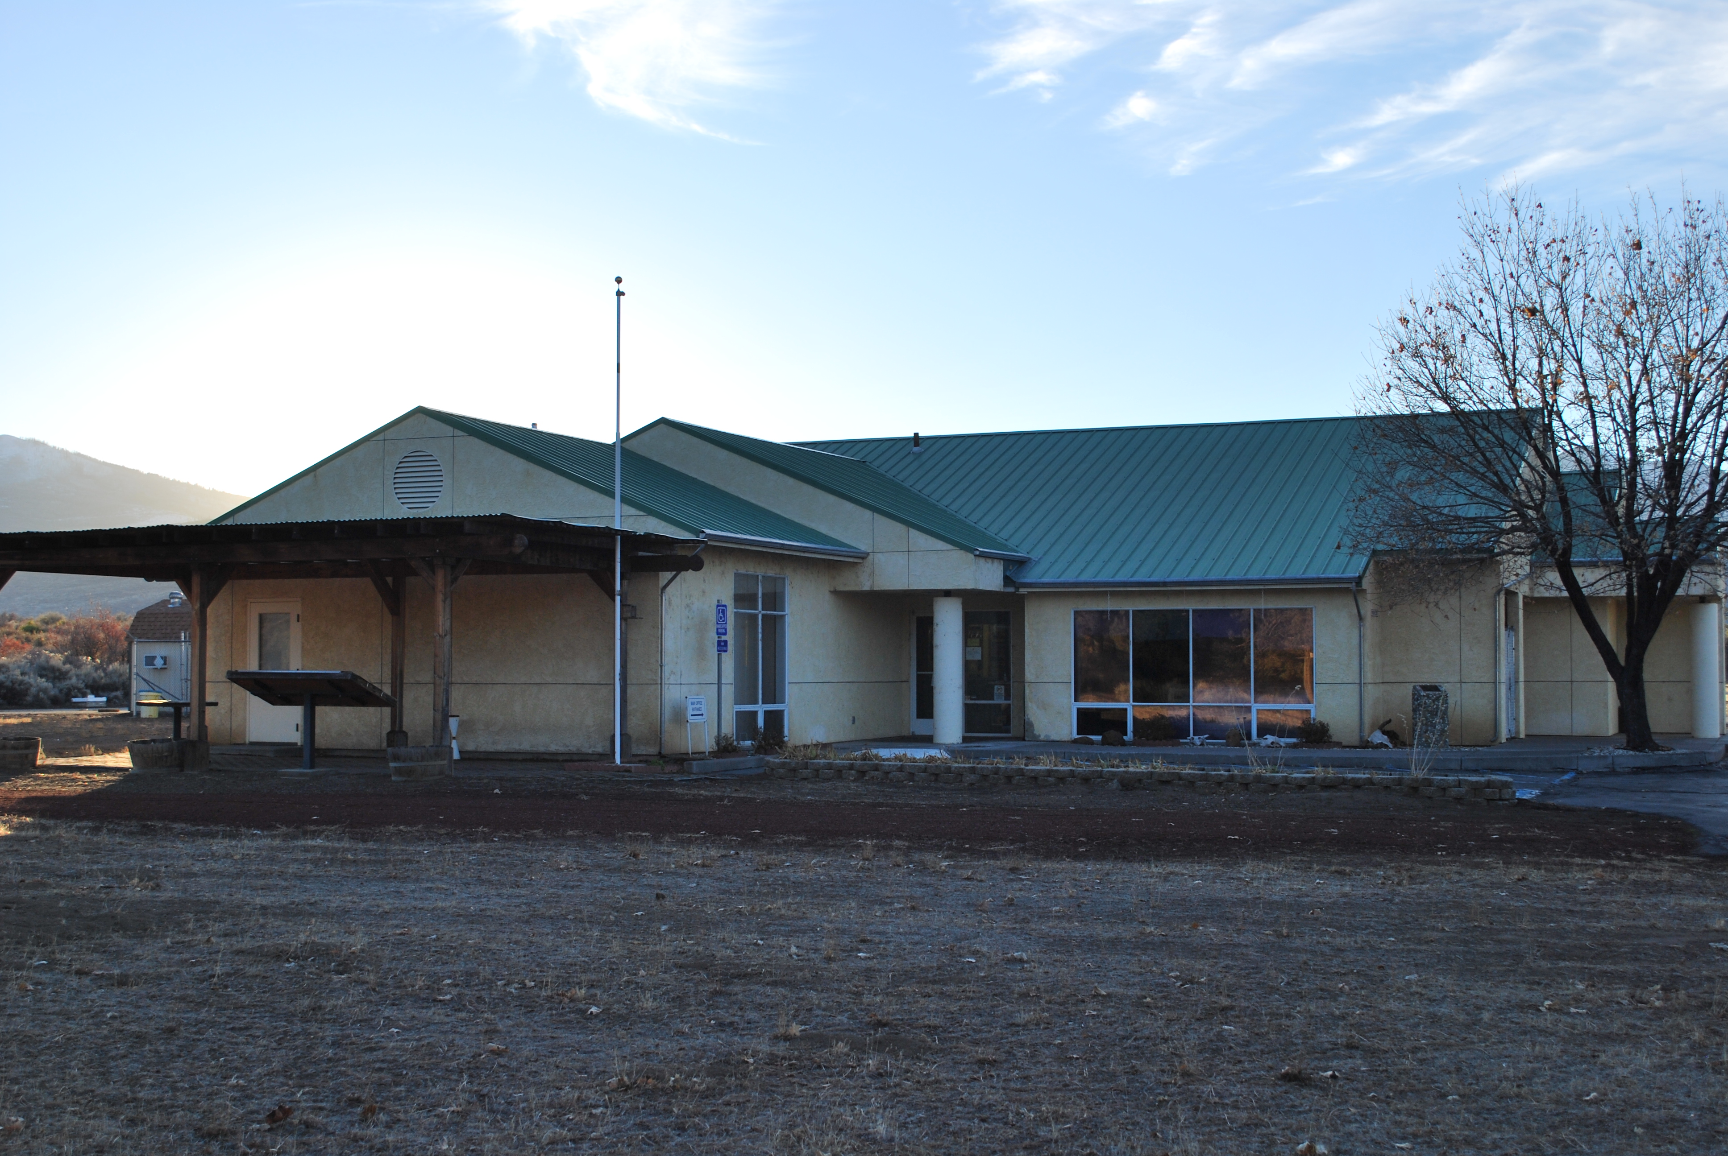
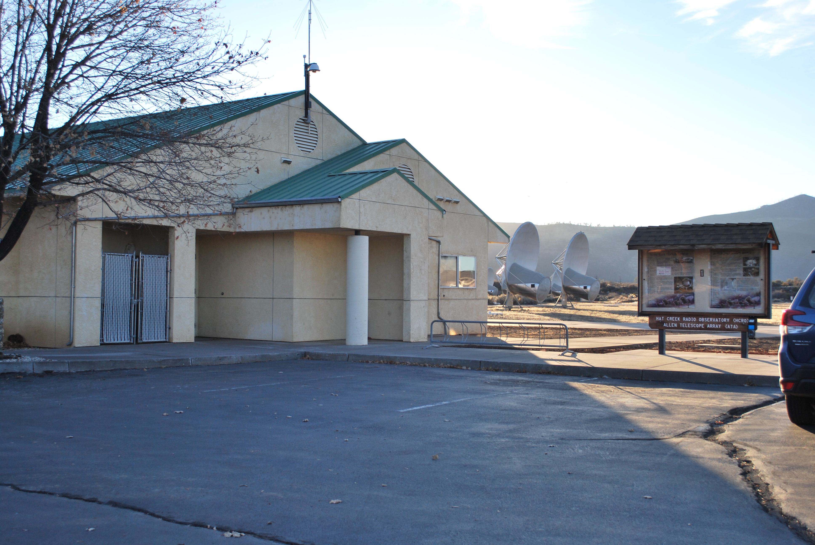
Visitor Center from the east
Visitor Center from the northeast
Main Entrance

Slide 8
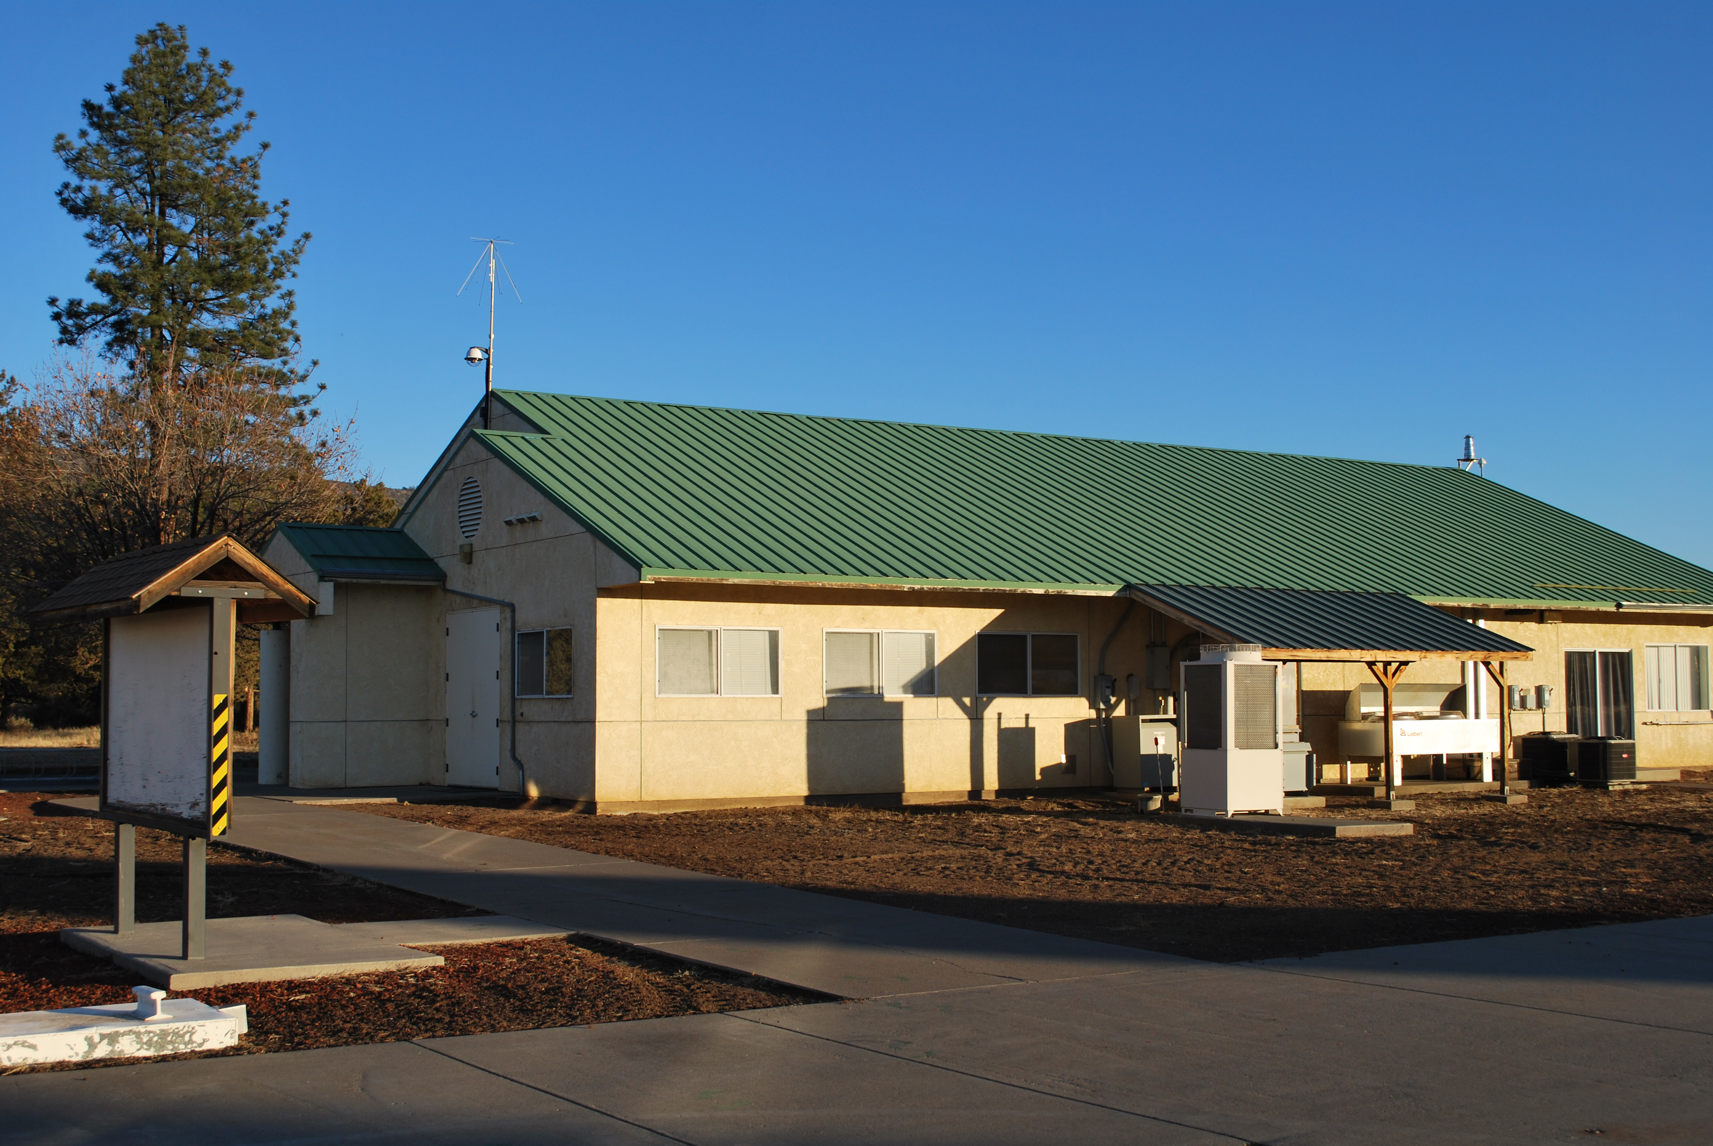
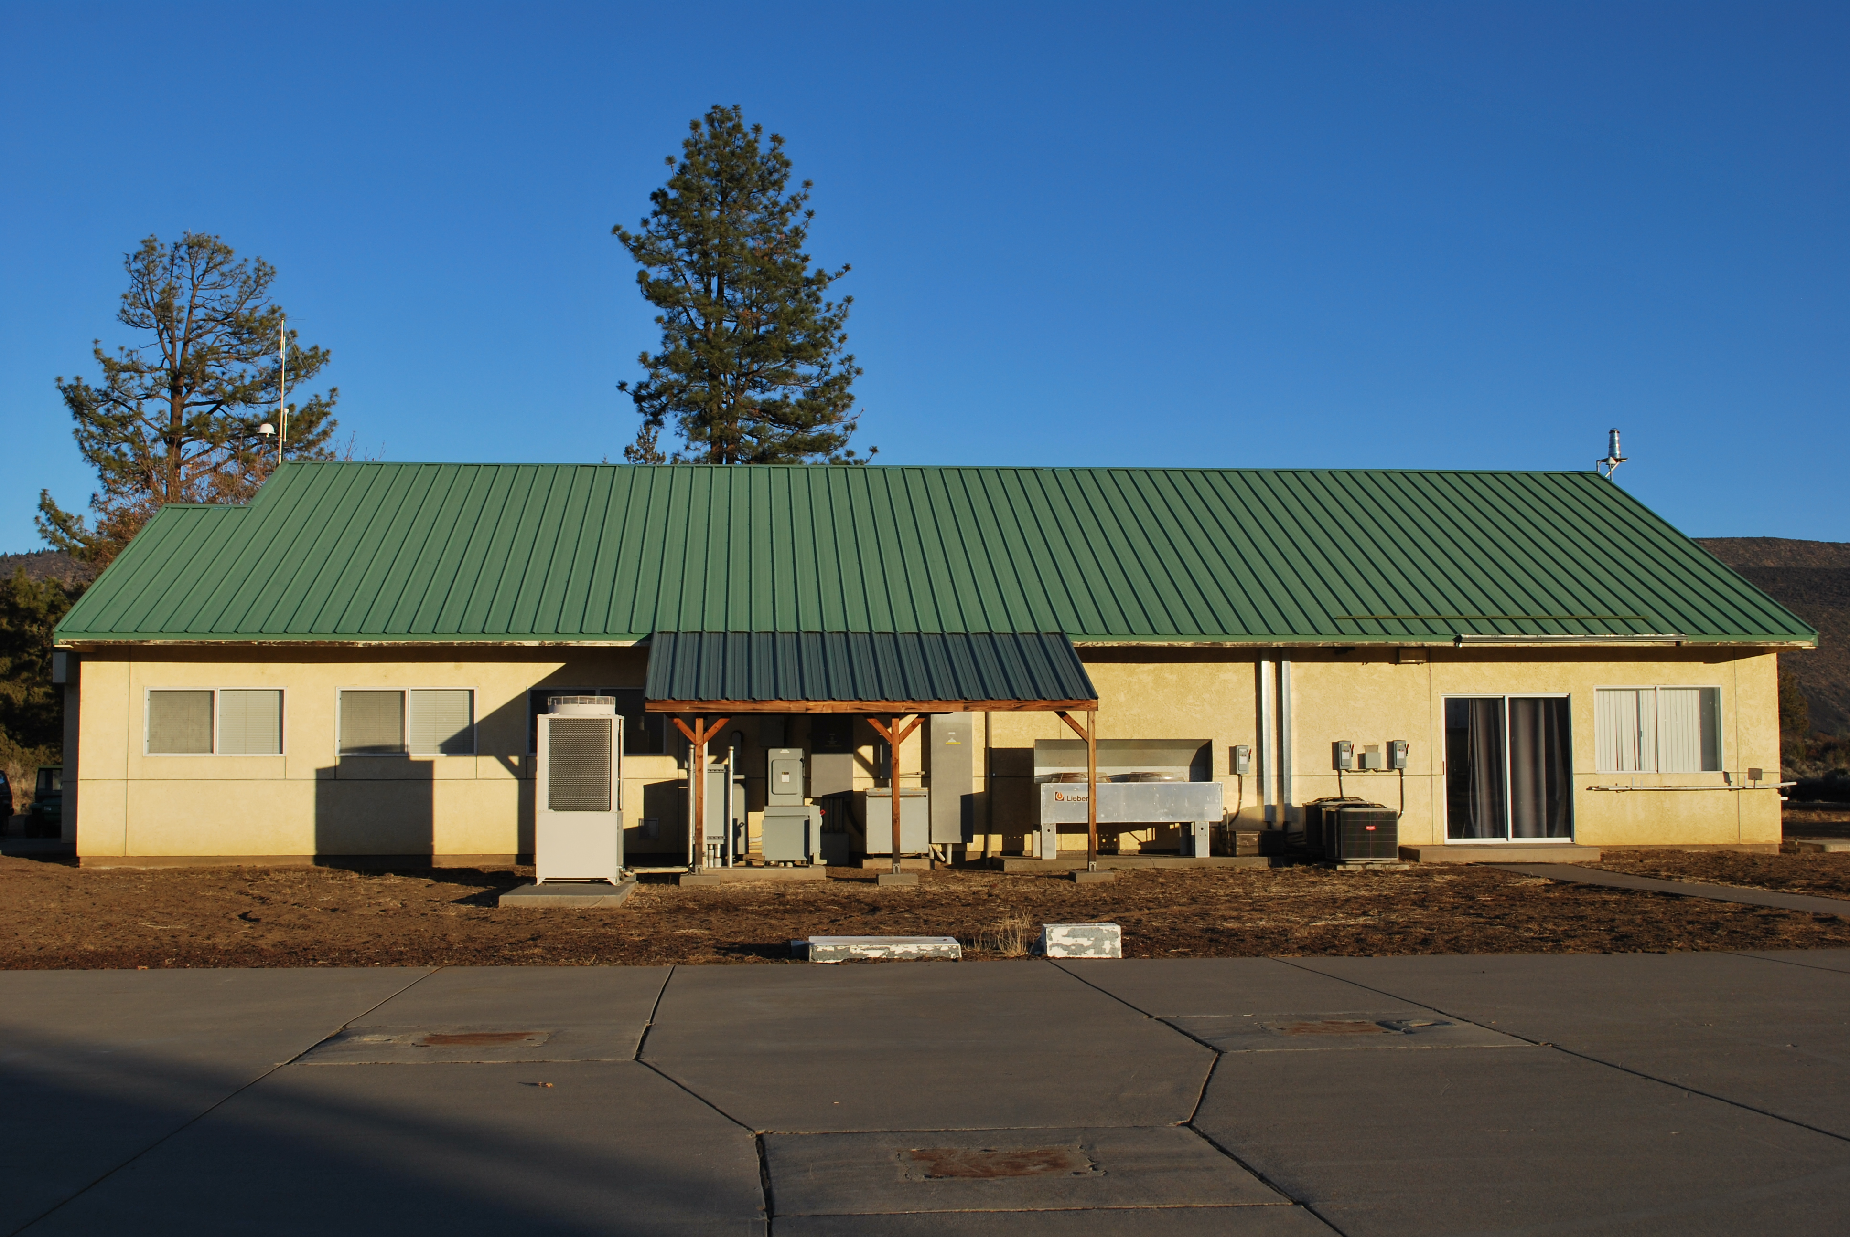
Visitor Center from the northwest
Visitor Center from the west

Slide 9
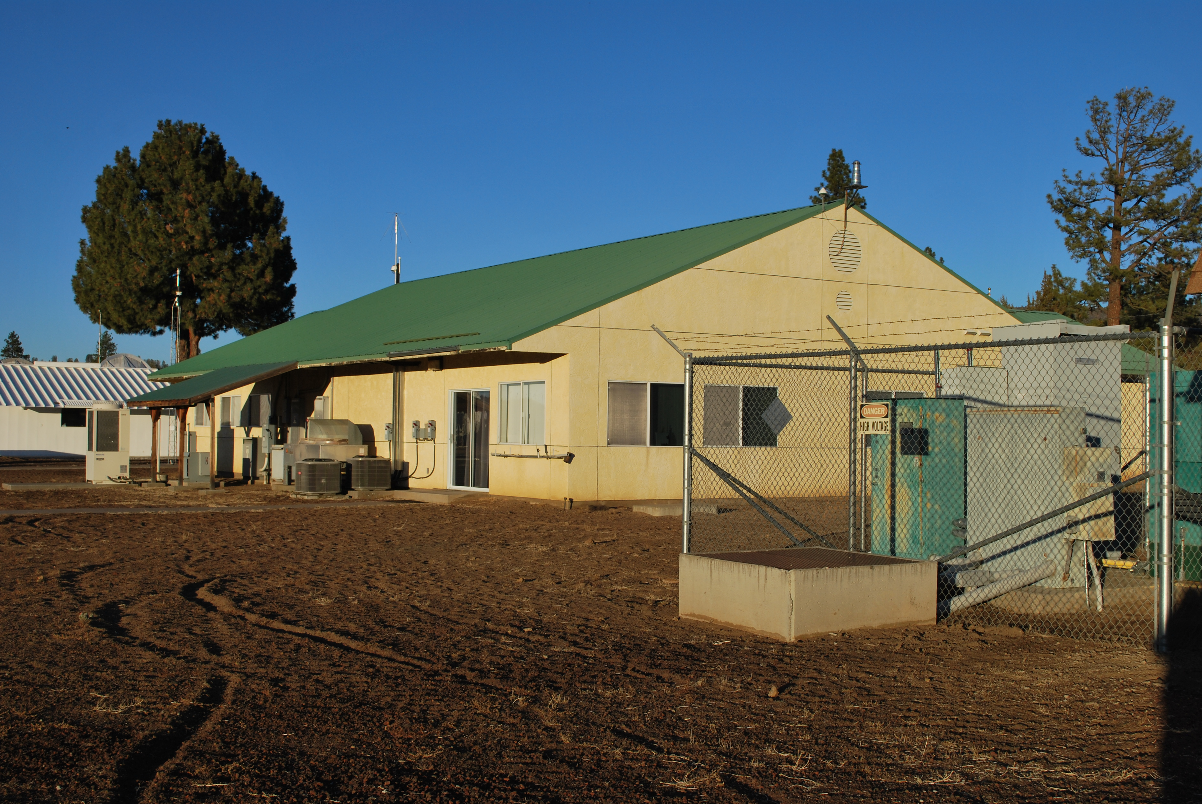
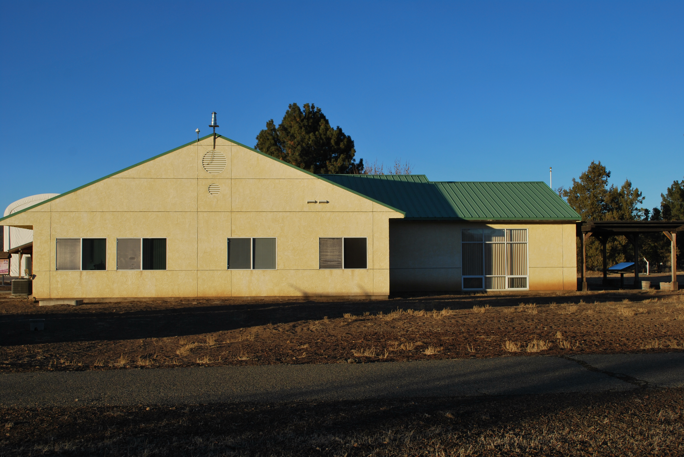
Visitor Center from the southwest
Visitor Center from the south

Slide 10
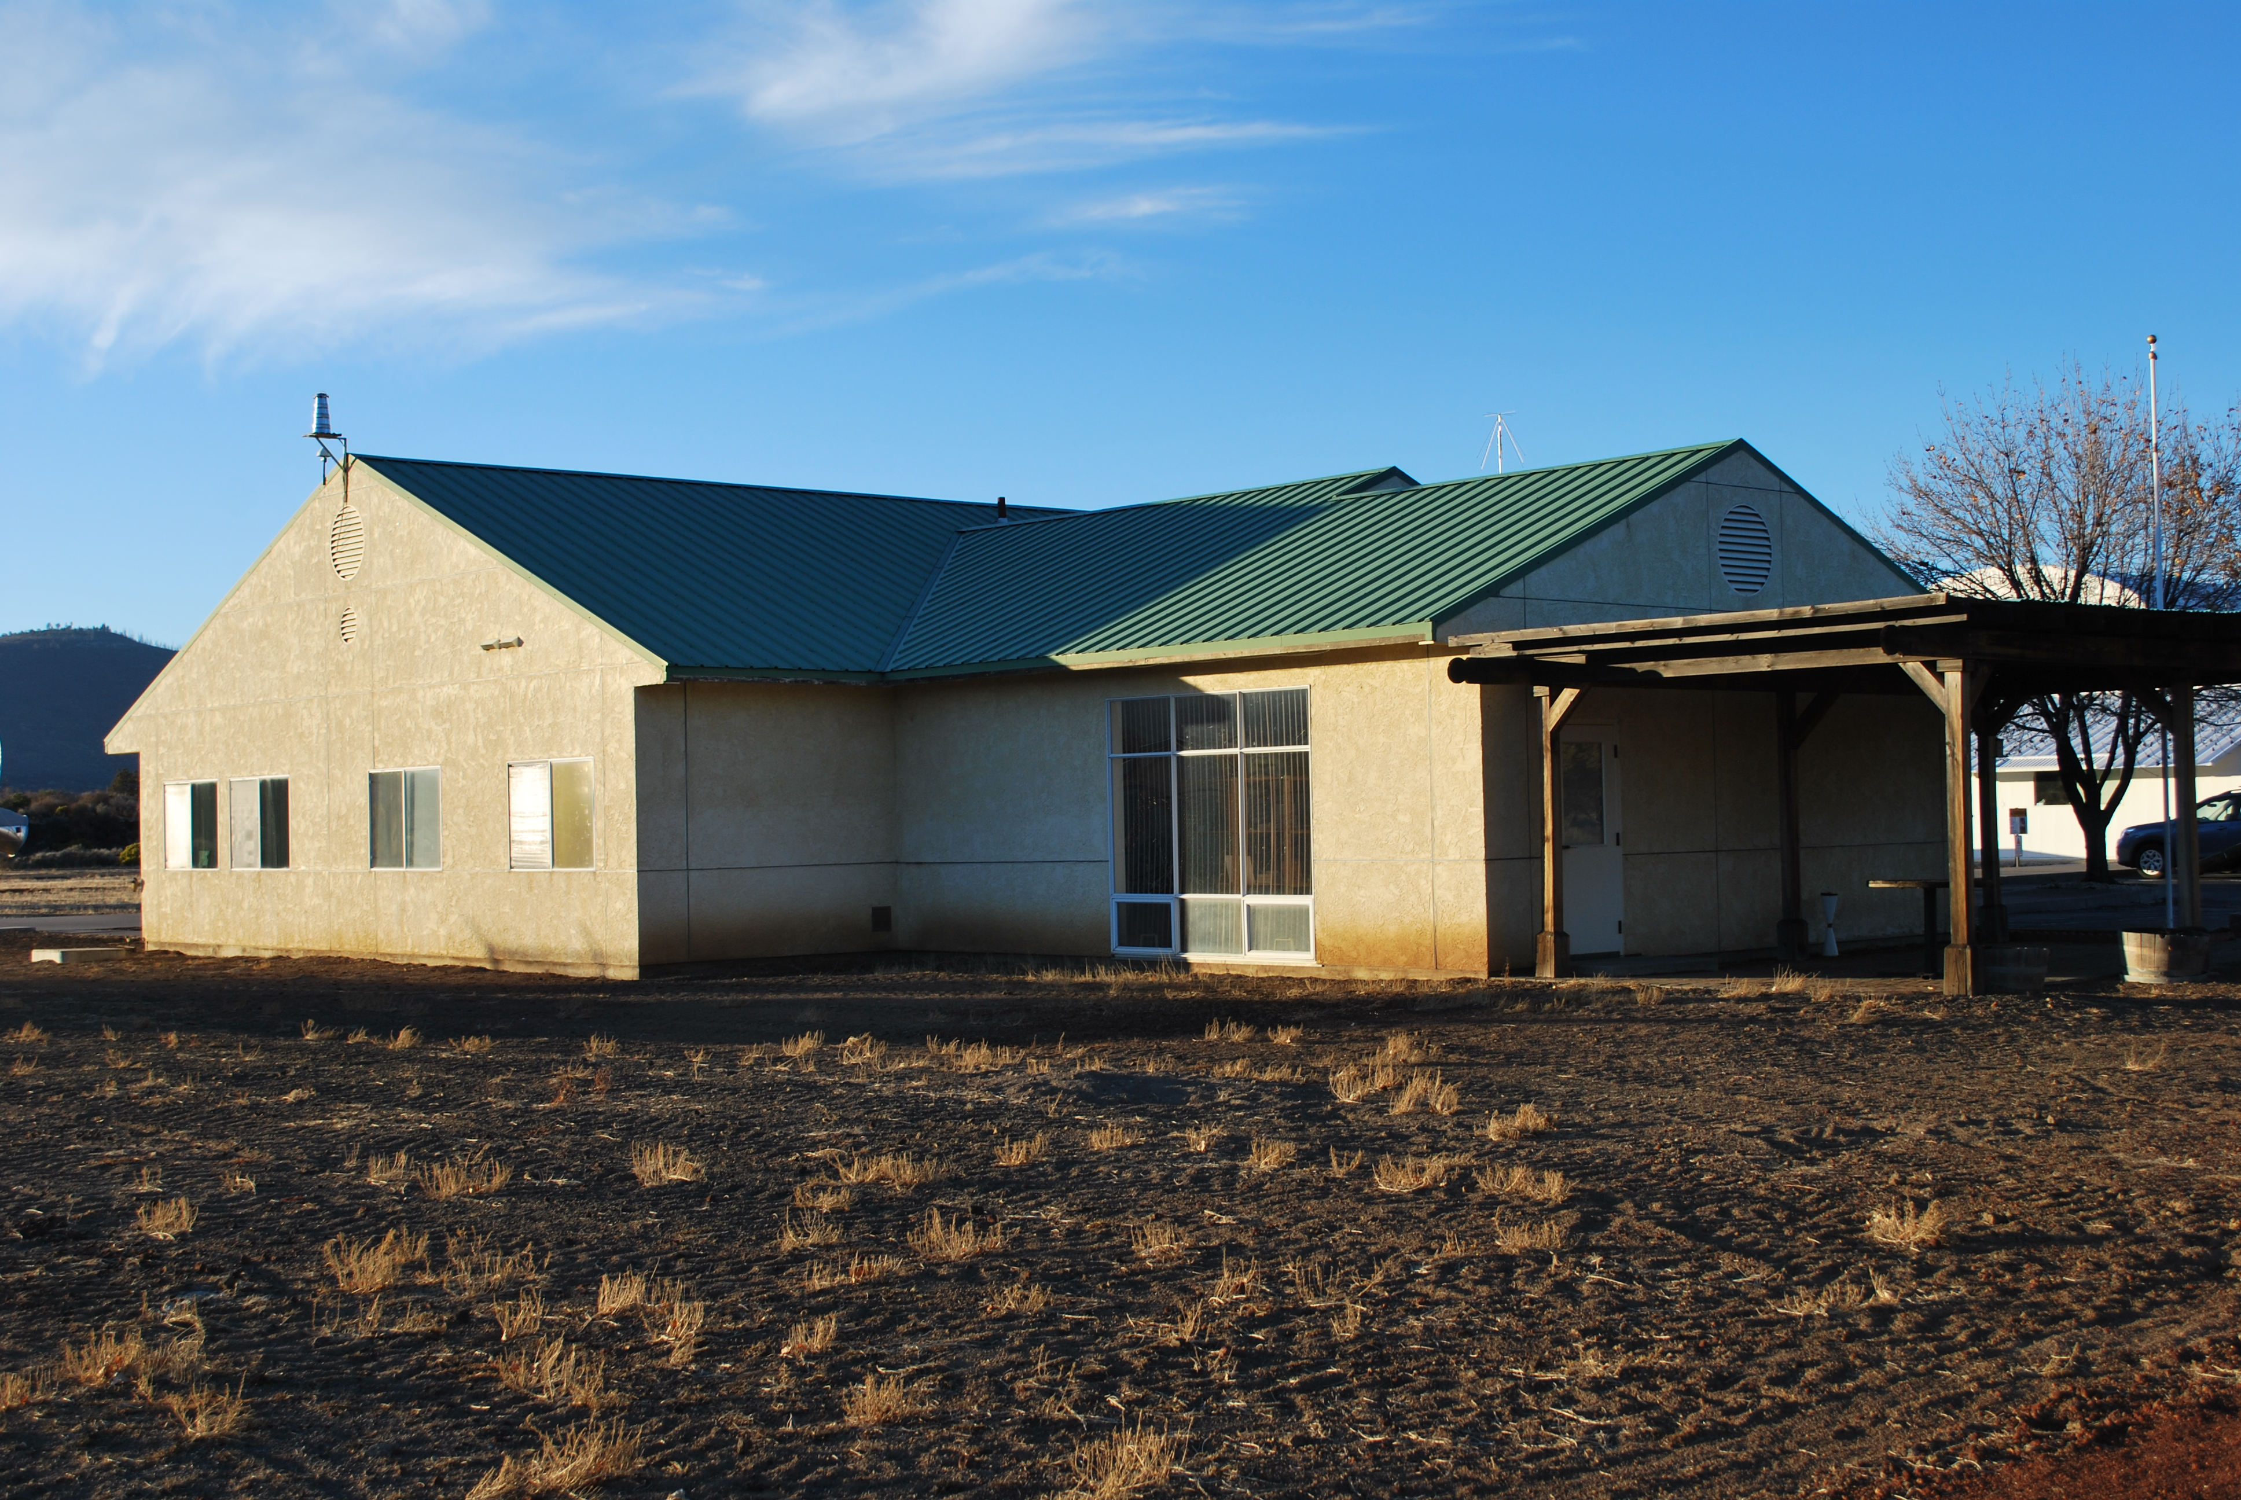
Visitor Center from the southeast

